Slide 1
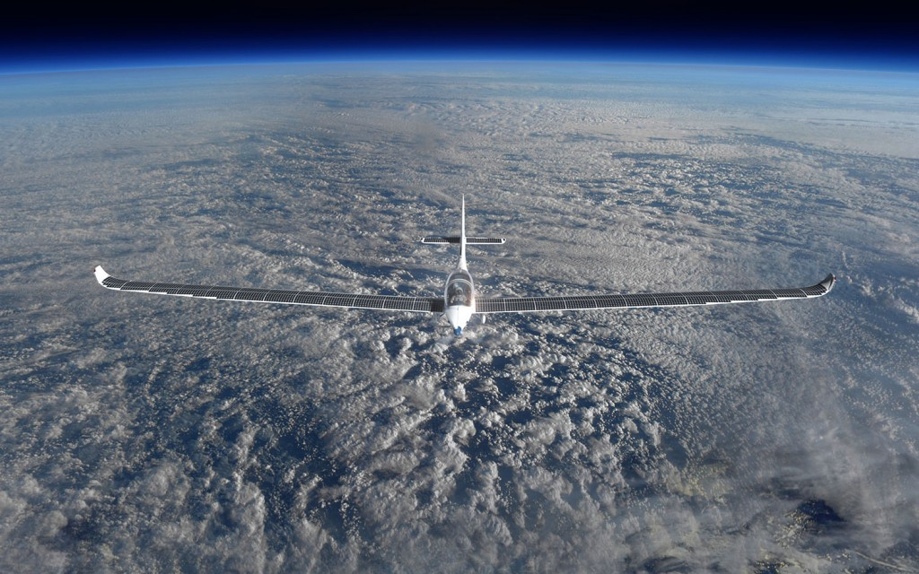
Unlocking the potential of Near Space
Chinese – Belgian Innovation Dialogue, March 30th, 2017
Steven Krekels , Unit Manager Remote Sensing

Slide 2


We believe in the power of technology, economic dynamics and the creativity
of people to leverage things.

Slide 3
Seamless Chain of Space Innovation
Industry
Society
Consumer
Public
INVENTION
TRANSFER
INNOVATION
VITO Remote Sensing playing field
Basic
Research
Applied
Research
Technology
Development
Project
Missions
Markets &
Public Applications

Slide 4
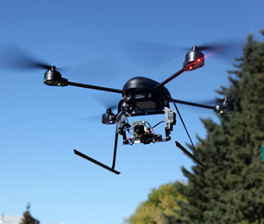
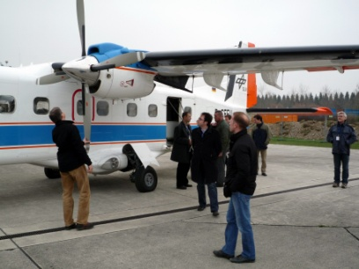
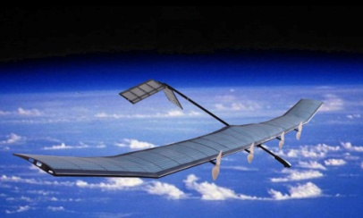
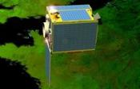
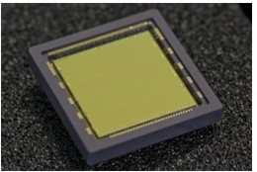
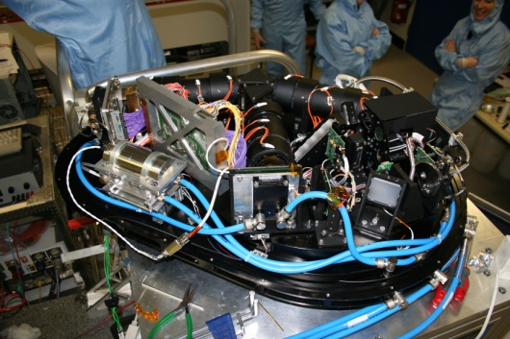
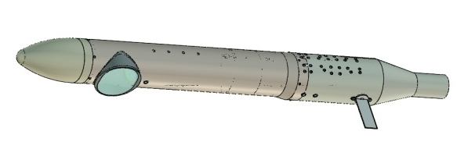
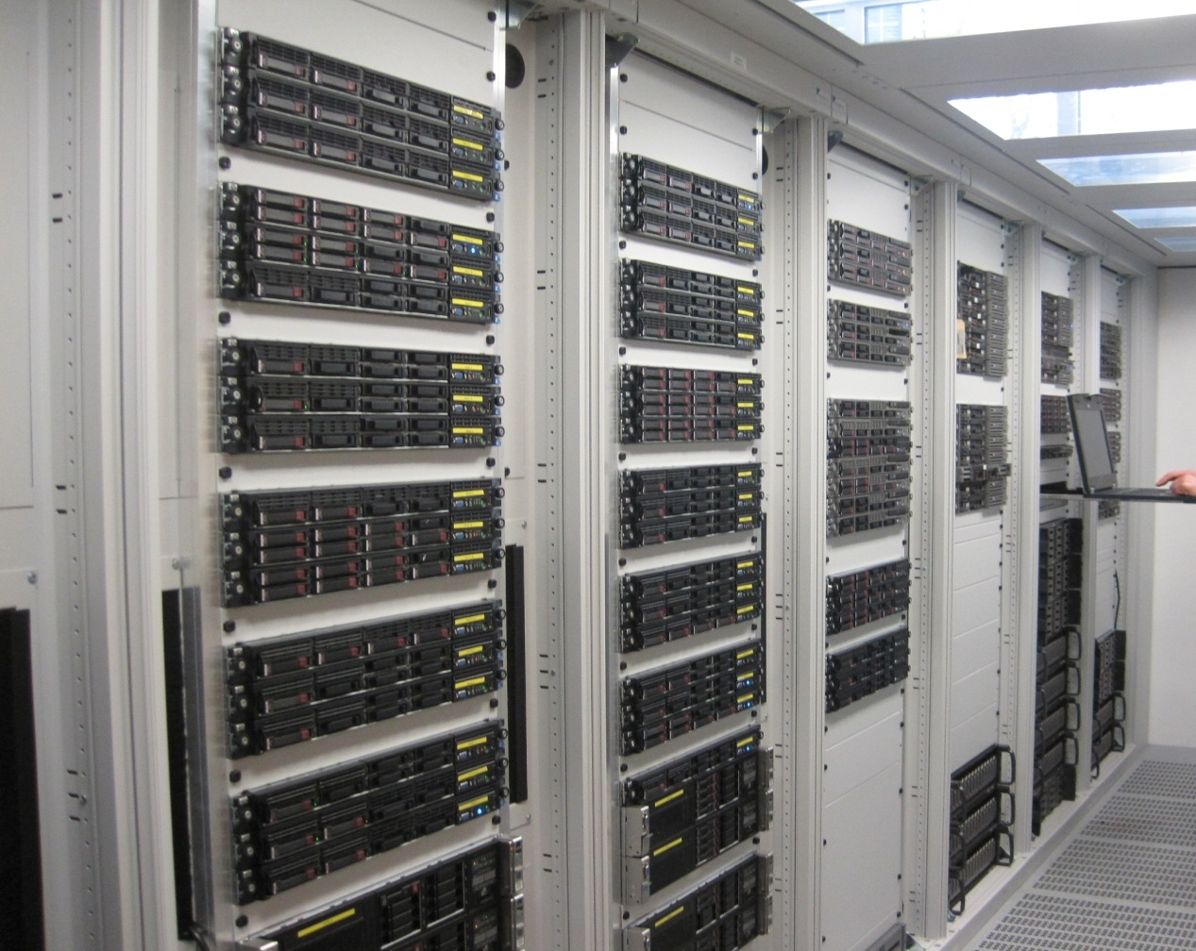






Platforms
UAV
AIRBORN
HALE UAV
SATELLITE
Sensors
Value Added Services & Information Products
Markets
Agriculture
Landuse & Biodiversity
Climate
Water & Coast
Infrastructure
Security

Slide 5
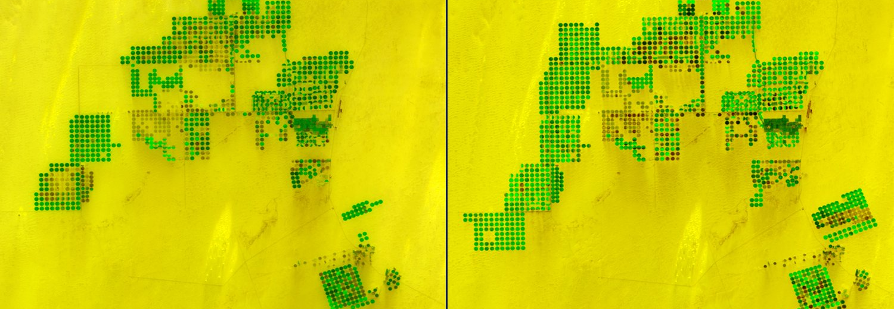
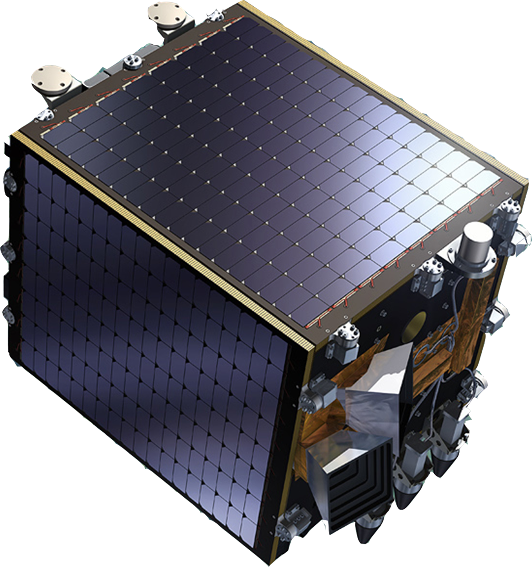
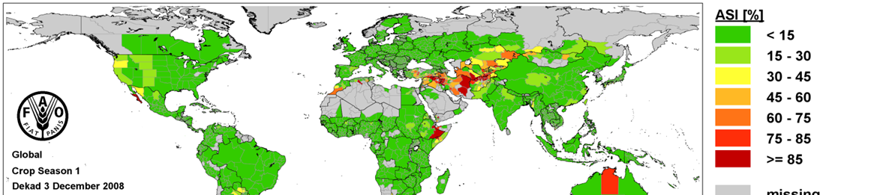

Slide 6

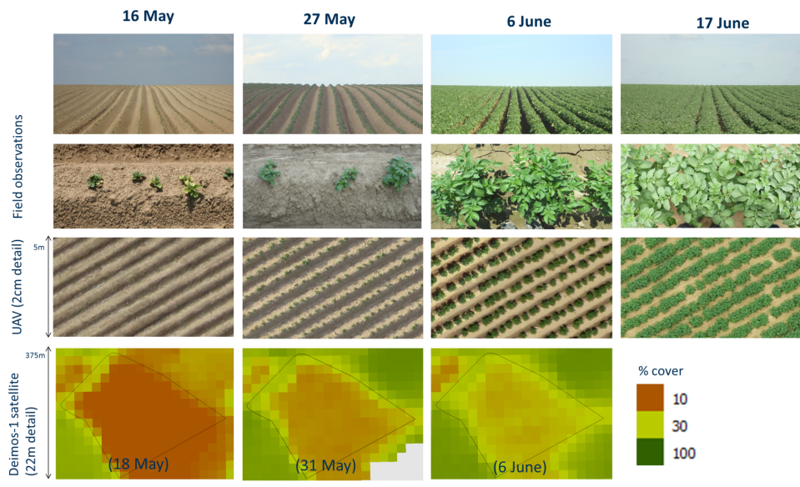
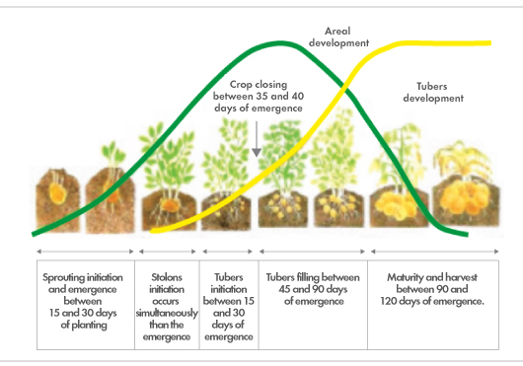

Belgian potatoes are monitored from space!
Greenness index
More info https://watchitgrow.be/en

Slide 7
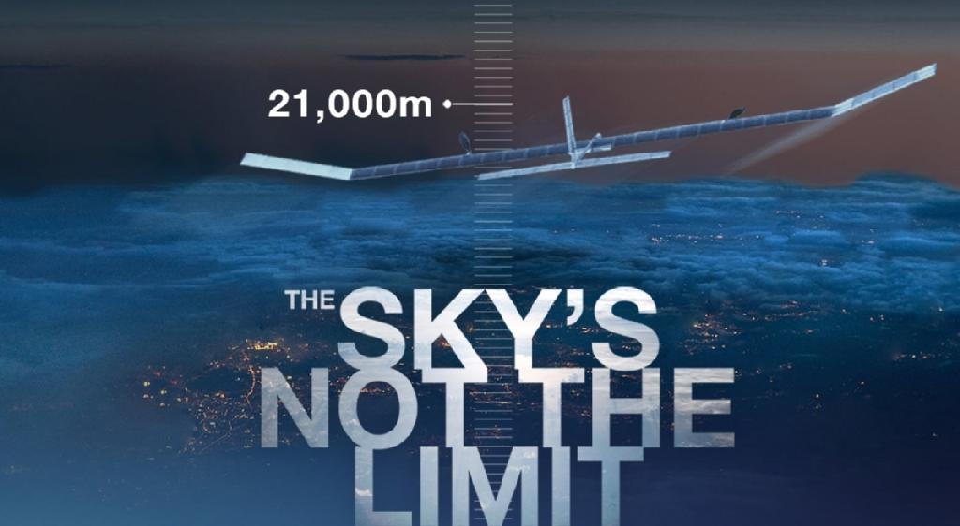
Near Space
40 000m
National Near Space
Felix Baumgartner (39 000m)
Joe Kittinger (31 000m)
Weather Balloon (25 000m – 30 000m)
Stratospheric Drones(17 000m – 23 000m)
18 000m
National Airspace
Boeing 747 (14 000m)
Mount Everest (8 848m)
Sea Level

Slide 8
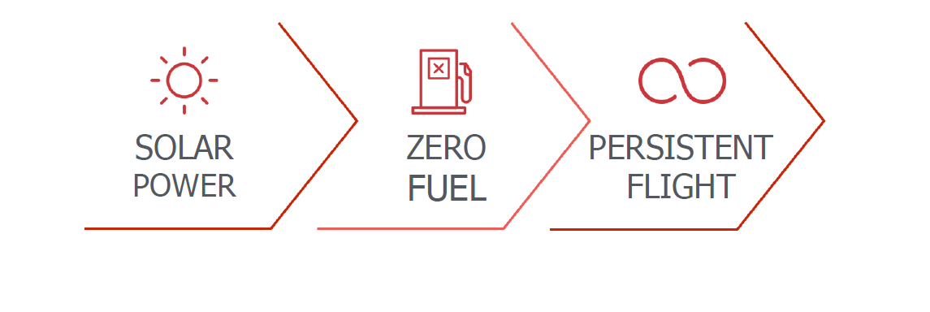
High Altitude Perpetual Flying

Slide 9

The Unique Advantages of Near Space Missions
High altitude platforms can perform either station keeping or dynamically adapt their route for tracking and optimum site revisits
Stratospheric drones can move from region to region as required and can be quickly repositioned, repurposed and upgraded
Typical Missions: infrastructure inspection, large farmland diagnostics, large scale mapping, disaster monitoring, border patrol, pollution, fishing vessel monitoring….
Persistent
Tracking
Scanning

Slide 10
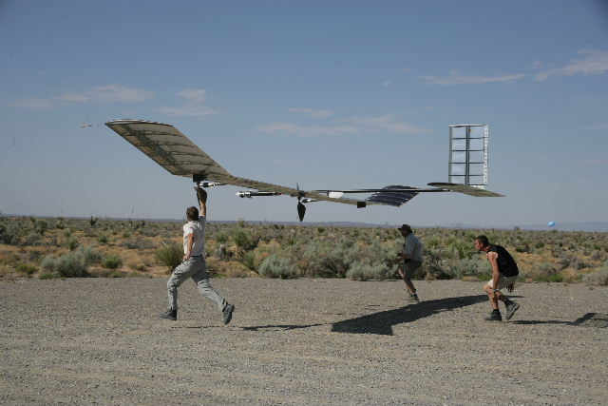
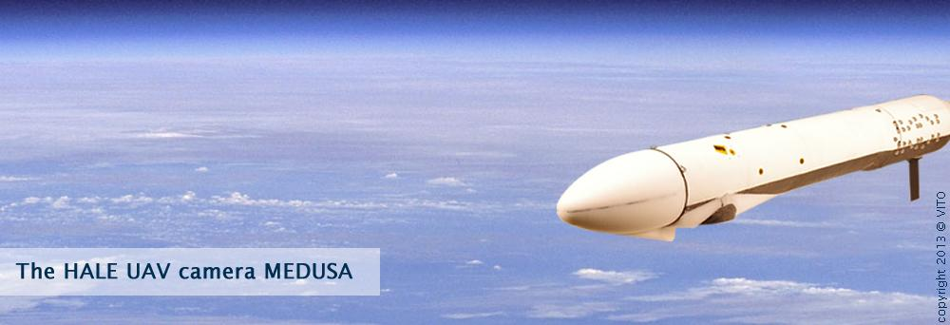
VITO Remote Sensing in Near Space
2010 QinetiQ: 14 day mission (endurance record)
2013 Airbus: first stratospheric flight
2014 Airbus: 11 day mission (in winter conditions)
2014 Airbus with EIAST: 61 696ft with full day/night operation
More info http://medusa.vgt.vito.be/

Slide 11
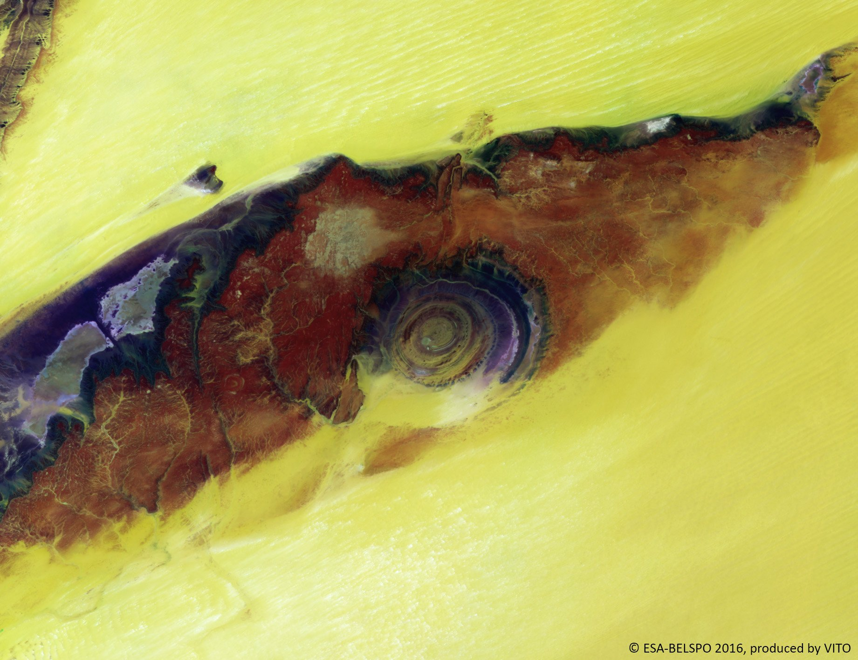
Steven Krekels
Steven.krekels@vito.be
T +32 14 33 68 11
W remotesensing.vito.be
Thank you !

